Slide 1
Introduction to Arduino
Phenomena

Slide 2
Arduino IDE
Please download Arduino IDE (integrated development environment) from the website to your computer.

Slide 3
A Quick Thought
Service Opportunity
Tech Help @ retirement home(s)

Slide 4
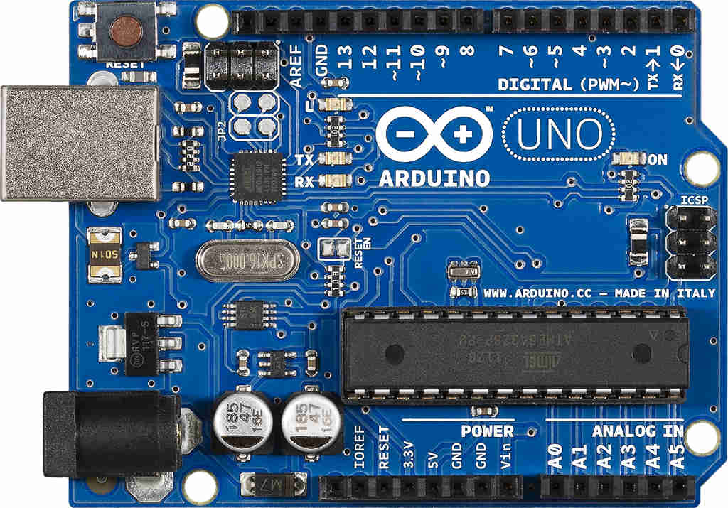
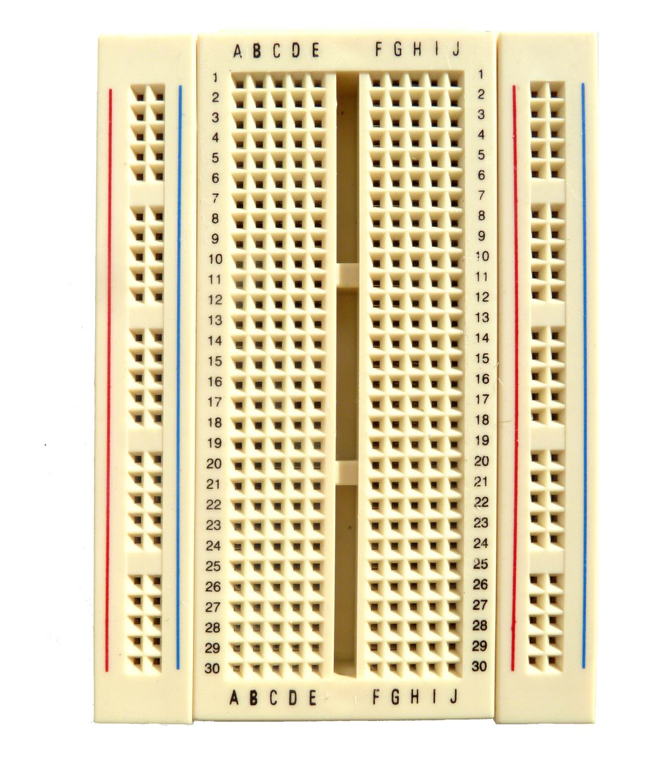
Quick Review
What is an Arduino?
How to use a bread board?
What is the different between digital and analog I/O?

Slide 5
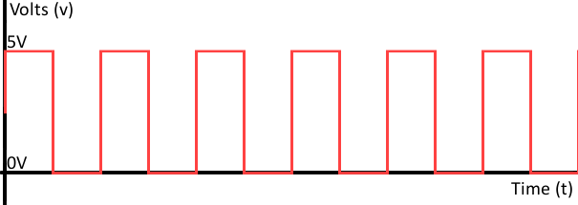
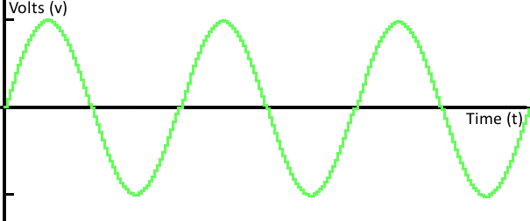

Slide 6

Today’s job
S.O.S distress signal
https://www.youtube.com/watch?v=CETGq7sqytE

Slide 7
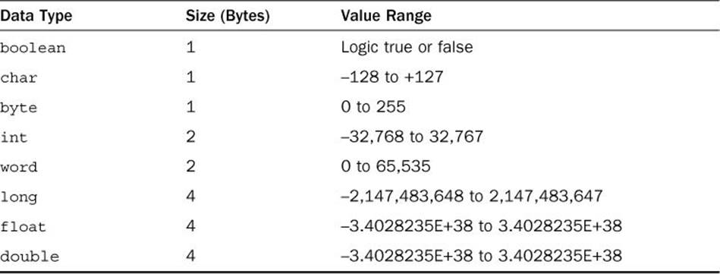
Data-Type

Slide 8

S.O.S distress signal

Slide 9
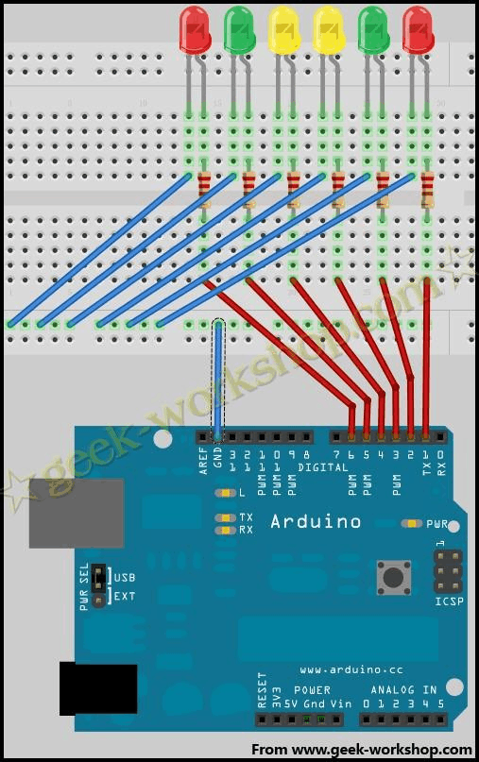
Circuit Connection Example

Slide 10
Your Turn!
Let’s have some music

